Slide 1
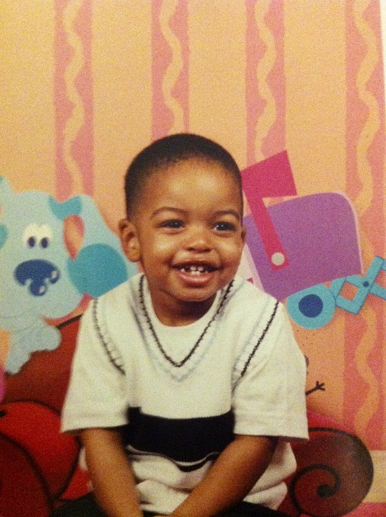
All About Me
By: Cranston Wright III
3/7/13
1st Hour

Slide 2
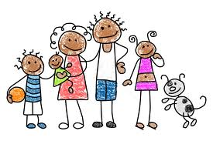
Parents And Siblings
I have only one brother and of course 2 spectacular parents my Cranston Wright Jr.(39), mom Kimberly Wright(38) and younger brother Cameron Wright(9) .

Slide 3
Childhood
I was born April 8, 1999 in Detroit, Michigan and attended Old Redford Academy in Kindergarten-1^{st Grade} and came to Bates for Academy 2nd -8th Grade. Played basketball, soccer and football since I was little. I mainly play basketball. I like to fish and sleep as well.

Slide 4
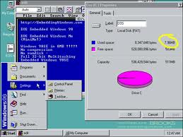
What Was Happening?
When I was little I didn’t live in the house I lived in now. Many other things happened like the euro was established, Bill Gates’ fortune reached over 100 Billion, Microsoft released Windows 98, a total solar eclipse was seen in Europe and Asia and an earthquake and tsunami hit Vanuatu.

Slide 5
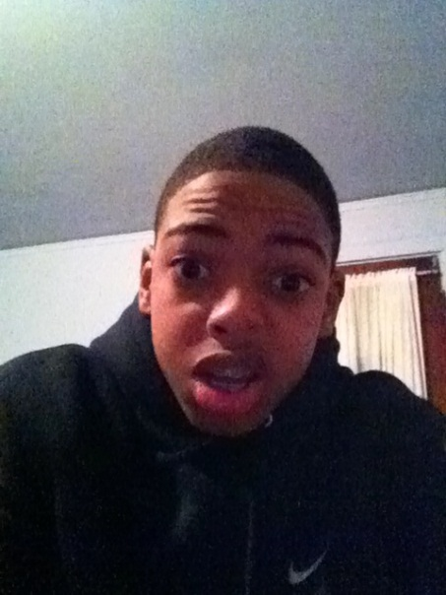
Me Today
Today I’m 13 years old and I am in 8th grade. I still play basketball and soccer I had to let football go. And I will be hoping to attend The Detroit Country Day School for high school.

Slide 6
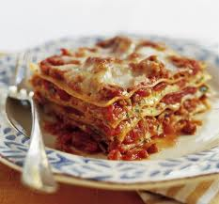
My Favorite Things
My favorite foods are Mac and Cheese, spaghetti with cheese and lasagna. I like to listen to Hip Hop/ R&B music. I love the color navy blue and I adore the sport of basketball. My favorite class is gym of course because I have a lot of adrenaline.

Slide 7
My Favorite Websites
I like to surf the internet an go on many websites here are my Top 5:
YouTube
Pandora
Not Doppler
Cranston Wright on Technology
ESPN

Slide 8
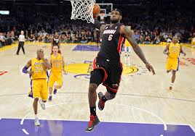
My Future Plans
In 10 years I see myself in the NBA. I see myself playing for an NBA team or if that doesn’t work out I see myself pursuing a job in the field of engineering.

Slide 9
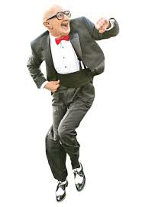
Something You Don’t Know About Me
One thing you don’t know about me is that I like to dance when I am absolutely bored.

Slide 10
My Name
My name was given to me by my Dad and I was named Cranston because he was named and Cranston. But my granddad always called me CJ so now my whole family calls me CJ even though I’m the 3rd so to this day we don’t know why he named me CJ.

Slide 11
References
"1999." Wikipedia. Wikimedia Foundation, 05 Mar. 2013. Web. 07 Mar. 2013.
"Dropbox - Simplify Your Life." Dropbox. N.p., 07 Mar. 2013. Web. 07 Mar. 2013.

